Slide 1
Roma housing and mainstream social housing policy in Bulgaria
Cases and patterns from Bulgaria
Boyan Zahariev
Open Society Institute - Sofia
Budapest 13/09/2013
Notes:
<number>

Slide 2
Social housing policy – the situation in Bulgaria
Practically no social housing – less than 3% of the total housing stock
Increased migration from villages to cities and away from depressed regions – consequence of failed regional development policies and the works of unregulated markets
A lot of poor quality housing (a time bomb) – prefabricated blocks of flats built during communism are coming close to the end of their life. Some located in Roma ghettoes have already been demolished.
<number>
Notes:
<number>

Slide 3
The three locations
Kystendil – South-West Bulgaria, 45 thousand, one big Roma ghetto
Dupnitsa – South-West Bulgaria, 34 thousand, at least five Roma neighbourhoods
Sofia – West Bulgaria, 1.3 milllion population, three of the biggest Roma neighbourhoods in Bulgaria and an unknown number of locations with illegal and extremely substandard (inhabited) housing
<number>

Slide 4
The case of Kyustendil – good sides
A successful but very limited and probably not replicable case of social housing (Kyustendil)
A risky mainstream social housing project funded by ERDF, which is still work in progress (Dupnitsa)
Where does housing deprivation come from (examples from the capital city)?
<number>

Slide 5
The case of Kyustendil – good sides
Quite successful – housing is maintained and does not deteriorate, utility bills are regularly paid, neighborhood relations are well managed and conflict-free
Small semi detached houses, close the usual pattern of inhabiting of the Roma in Kyustendil.
<number>
Notes:
<number>

Slide 6
The case of Kyustendil - deficiencies
A bit of social work, but not much support for employment, no additional income support
The project is hardly replicable beyond the specific protestant community
It covers a very small proportion of the needy who are generally not the neediest
.
<number>
Notes:
<number>

Slide 7
The town of Dupnitsa – work in progress
Work in progress, a project funded from the ERDF.
Small 2-3 floor condominiums with a total of 150 flats
Low cost subsidized rent
But the rent is not the main problem…
<number>

Slide 8
Utility bills are
<number>

Slide 9
Due to overindebtedness and inability to make end meet
<number>

Slide 10
Combined with inability to maintain the existing housing
<number>

Slide 11
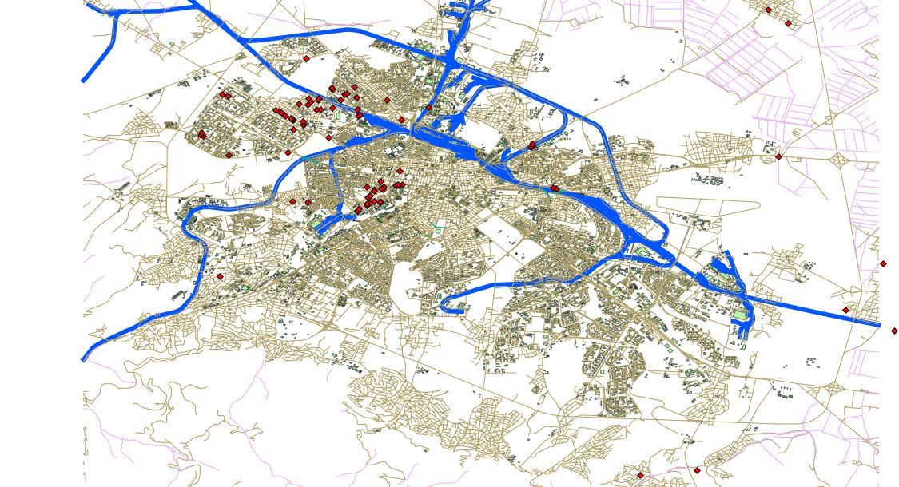
New (small but growing) ghettoes are emerging
(the spots of illegal accommodations in Sofia are shown on the map)
<number>

Slide 12
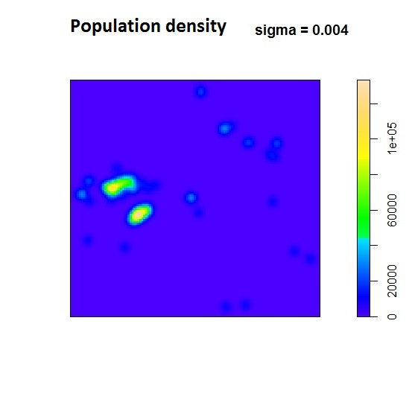
There are “hotspots” attracting the poor who move around looking for opportunities to have a decent life
<number>

Slide 13
The hotspots include
Places where other poor people and homeless people live
Places with existing poor and illegal housing
Abandoned industrial property
Poorly maintained and rarely used public spaces
Servitude areas of the transport and technical infrastructure
<number>

Slide 14
Housing deprivation persists because
Accommodations deteriorate and get dilapidated with time, especially when not properly maintained
Accommodations built by or inhabited by poorer people tend to be less durable and more poorly maintained
People die, new people are born. Among poorer groups population growth is faster. Some Roma groups follow traditional family patterns, prefer to live close to each other
People move (in communists times movement was administratively restricted to keep negative consequences from unbalanced development at bay. In the last 20 years people move a lot.
<number>

Slide 15
Conclusions
Housing deprivation is not just a matter of finding a solution for a list of existing places or for a list of existing households
It is a matter of unbridled economic and social forces which produce and replicate housing deprivation
<number>

