Slide 1
Private leasing schemes and social rental agencies
Emerging private rental sector in accession and transition countries:
Is there an option for social rental agencies?
Conference and Workshop,
Budapest 12-14 September 2013

Slide 2
Private leasing schemes and social rental agencies The French experiment
1 Why ? for what purposes ?
2 How ? Ways and means
3 Results ? Assessment of the effectivness

Slide 3
Housing supply in France
57.8% of households are owners of their primary residence
32% are still mortgagors
42.2% of households are tenants
44% of whom are in social housing
56% are in the private rental sector, mostly in condominium
Institutional investors have left the rented housing sector
95% of the stock of private rented housing is in the hands of private individuals, the majority of whom own less than three dwellings
Most rented accommodation is in condominiums
Private rented sector: 6.3 M dwellings, turnover rate: 27 %, 1.5 M new leases each year
3 years lease renewable, unless the landlord sells or takes it back for himself. Lease increases with inflation.

Slide 4
Housing policy
Public spending # 2 % GDP, the largest part, 16 billion euros, or 43%, goes towards housing benefit, mostly housing benefits paid out to tenants.
Housing expenses /household income
1970 : #10 % 2006 : # 20 %
This progression has been more important for low income households (in the 3 first deciles)

Slide 5
The legal background of right to housing
Rough sleeper: it is mandatory for the central government to provide shelter, but it is not mandatory for the person to accept.
“Solidarity and urban renewal” law (2000) obliges urban towns (with more than 3,500 inhabitants in agglomerated areas) to have at least 20% social rented housing. Since 2013, the rate is 25%. Half of the “communes” that are supposed to have 20 % of social housing do not meet this goal.
DALO law (2007) establishes an enforceable right to housing: a person who cannot find accommodation, having applied unsuccessfully for social housing, is entitled to ask the government for a dwelling.

Slide 6
Expensive areas with insufficient social housing supply
Paris average rent in the PRS: €25 per sqm, Social housing : €7 per sqm
In some relaxed housing markets the level of the rent between the private and the social rented sector can be very close
Areas with the greatest wealth also contain the greatest of deprivation
Increase the opportunity for rent under the market price in expensive markets
House people who cannot access housing because of insufficient income and also because they need some kind of social support

Slide 7
1 General scheme / Agreement between the landlord and a state agency (Anah)
The landlord signs an agreement with a state agency, “l’Anah”
The term of the agreement is 6 or 9 years, depending on whether improvement works have been partly funded by a public grant
The landlord gets a tax deduction
The tenant resources must be under a ceiling

Slide 8
The lower the rent, the higher the tax deduction
Level of tax deduction
30% of the rent = The tenant has a common right lease.
60% of the rent = The tenant has a common right lease.
70 % = The dwelling is rented to a non-profit organisation
to provide temporary housing or
to sublet to disadvantaged persons who need temporary accommodation. In this case, the occupant of the dwelling must be proposed by the central government.
In each case a maximum rental charge must be respected.
The tenant can get a rental allowance (housing benefit).

Slide 9
2 Private leasing schemes and social rental agencies
These schemes were based on the English private leasing scheme
To house very low income households who cannot find a dwelling either in the private or the public rented sector because of
Insufficient income
Need for some kind of social support (complex behavior)
Often as an alternative to the hotel room paid for by the local or central government
Possibly, to provide a getaway from traditional housing

Slide 10
Persons who might be eligible for theses schemes
Household sheltered in hotel by the public authorities
Household in public shelters for excluded people
Household living in substandard dwelling before the beginning of improvements works
Household facing eviction and remaining in the dwelling as sub-lessee
Several households sharing a single dwelling
Household with a priority status according to the DALO law

Slide 11
First scheme : Management mandate
Occupant has a common right lease < 25 or 30 % of the household income
The landlord asks a non-profit to manage the property (social rental agencies : AIVS)
The non-profit takes care of the social support

Slide 12
Second scheme : sublease “ SOLIBAIL” or “Louer solidaire” in Paris
The lease is between the landlord and the non-profit for renewable three-year periods
The non-profit manages the housing and pays the rent to the landlord
The non-profit signs an agreement on temporary occupation with the occupant
The non-profit can, if the landlord agrees, transfer the lease to the occupant

Slide 13
The household
Tenant with a common right lease
Sub-lessee
Sub-lessee for a transitional solution
The occupant can get the lease transferred, if the landlord agrees

Slide 14
For the landlord
Guaranteed rent paid monthly, even in case of vacancy
Professional management service
Property returned dilapidation free
Social support of the occupant of the dwelling
Tax deduction and various kinds of grants

Slide 15
Various kinds of social rental agencies
Some own their own dwellings and some manage properties owned by others
Search for rental housing, help the owner for the administrative relations with local government or ANAH
Must have the same knowledge as a real estate agent
Must have an agreement and a financial guarantee for:
Management of social policies; and/or
Management of private lease schemes
Social Lettings Agency are mostly financed by national and local governments and by various social security funds

Slide 16
1 Results and assessment: quantities
On the government agenda
500,000 new constructions a year, 150,000 being social housing
ANAH :
# 5,000 dwelling in “social” (30 % of tax deduction)
# 500 in the “very social” in 35 départements (60 or 70 % of tax deduction)
Sublease
Management mandate # 18,000
Sublease “SOLIBAIL” # 20,000

Slide 17
2 Results and assessment : Costs
The comparison with social housing does not make sense
Cost renewable vs. investment
Temporary solution vs. social asset
But, geared toward households who cannot get access to standard dwelling
The comparison with hotel rooms seems to be correct and perhaps less expensive

Slide 18
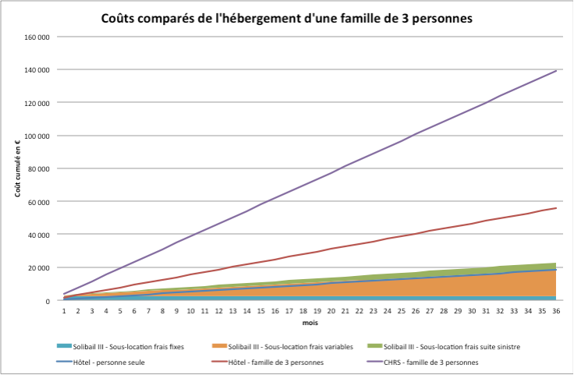
Comparatives costs for a 3 person household

