Slide 1




Tenancy Law in Europe
The ZERP Tenlaw Project and its Focus on Regulatory Failures
Christoph U. Schmid, ZERP, Bremen

Slide 2
TENLAW - Tenancy Law and Housing Policy
in Multi-level Europe
Concept of the Project
Cooperative Project under EU FP 7
Consortium organised into 10 teams
  University of Bremen, Germany
  University of Pisa, Italy
  Technical University Delft, the Netherlands
  University of Tartu, Estonia
  University Rovira i Virgili, Spain
  University of Lund, Sweden
  University of Silesia, Poland
  International School for Social and Business Studies Celje, Slovenia
  University of Southampton, United Kingdom
  Metropolitan Research Institute, Hungary
Consortium will cover 31 European countries
  EU 27+4 (Scotland, Switzerland, Croatia, Serbia)
  Further voluntary participants: Norway, Japan, Wisconsin

Slide 3
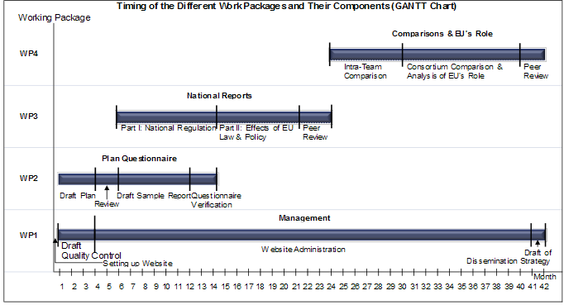
Implementation
TENLAW - Tenancy Law and Housing Policy
in Multi-level Europe

Slide 4
Objectives
TENLAW - Tenancy Law and Housing Policy
in Multi-level Europe
Objectives
1 | Analysing national tenancy regulation in context (questionnaire to be answered by national reporters) - Housing situation and housing policies (part 1) Tenancy Law (part 2)
2 | Analysing the effects of EU law and policies on national tenancy law
3 | Comparing national tenancy systems in similar groups of welfare states and at European level “Open method of coordination”: mutual learning and definition of best practises
4 | Determining a possible future role for the EU in tenancy law

Slide 5
Objectives (1)
TENLAW - Tenancy Law and Housing Policy
in Multi-level Europe
Objective 1: Analysing national tenancy law in context
  Development and current situation of national tenancy law
  Tenancy law’s embeddedness in housing policy and housing markets
  Tenancy law and procedure “in action”
  Single fields of Tenancy law
    conclusion of tenancy contracts;
    duration and termination of contracts;
    rent fixing and rent increases;
    obligations of the parties

Slide 6
Objectives (2)
TENLAW - Tenancy Law and Housing Policy
in Multi-level Europe
Objective 2: Analysing the effects of EU law and policies on national tenancy law
  social policy against poverty and social exclusion
  consumer law and policy
  competition and state aid law
  tax law
  energy saving rules
  private international law including international procedural law
  anti-discrimination legislation
  constitutional law affecting the EU and European Convention on Human Rights
  harmonisation and unification of general contract law

Slide 7
Objectives (3)
TENLAW - Tenancy Law and Housing Policy
in Multi-level Europe
Objective 3: Comparing national tenancy systems in similar groups of welfare states and at European (i.e. consortium) level
  compare important features of tenancy regulation, including security of tenure, rent control, and guarantees of habitability
  compare the different roles of tenancy law in national housing policies
  compare tenancy laws as integral parts of national housing policies as regards their connection to different welfare state systems
basic parameter of evaluation of national regulation
  the hypothesis of a socio-economic balance, to be respected by national regulation

Slide 8
Objectives (4)
TENLAW - Tenancy Law and Housing Policy
in Multi-level Europe
Objective 4: What future role for the EU in tenancy law?
  Open Method of Coordination (OMC) – best practises (e.g. common principles of “good tenancy regulation”), mutual learning, peer review etc – first step: evaluate failures of different national housing systems
  Extending the social dialogue to the field of Tenancy Law
  Minimum harmonisation under European consumer law
  Full harmonisation under Art. 114 TFEU – not an option for residential tenancies
  A balanced European contribution to tenancy law would enhance the legitimacy of the EU in the eyes of its citizens.

Slide 9
TENLAW - Tenancy Law and Housing Policy
in Multi-level Europe
Preliminary Results – General (1)

Slide 10
Preliminary Results – General (2)
TENLAW - Tenancy Law and Housing Policy
in Multi-level Europe
Most failures are less, at best indirectly, related to private tenancy law, e.g. overcrowding, housing poverty etc.
Failures clearly related to private law are particularly relevant in this project, in particular
  Excessively high rents
  Supply problems/insufficient availability in private sector
  Discrimination in access to housing
  Adverse economic and social phenomena directly related to regulation (e.g. landlord prefers to leave dwelling vacant because of strict rent regulation)
  Unjust intertemporal splittings among different tenancy laws
  Problems related to estate agents
  Black market phenomena

Slide 11
Failures in the Regulation of Private Tenancies
TENLAW - Tenancy Law and Housing Policy
in Multi-level Europe
  Preliminary remark:
    first results are dealing with regulation of (typically market-dependent) private tenancies and not with the governance of social housing schemes of various kinds

Slide 12
Failures in the Regulation of Private Tenancies
TENLAW - Tenancy Law and Housing Policy
in Multi-level Europe
  (1) Excessively restrictive regulation of rent and security of tenure to the detriment of the landlord with the consequence that landlords are dissuaded from renting out dwellings any longer
    E.g. ECHR cases on Malta and Poland;
    previous equo canone - regime in Italy (until 1998)

Slide 13
Failures in the Regulation of Private Tenancies
TENLAW - Tenancy Law and Housing Policy
in Multi-level Europe
  (2) No or almost no protection of security of tenure
    Romania and Bulgaria: private tenancies treated as ordinary leases without special regulation (2004 – still true?)
    Assured shorthold tenancy (UK) gives only 6 months of security of tenure; deprives tenant of dignity, no justifications available

Slide 14
Failures in the Regulation of Private Tenancies
TENLAW - Tenancy Law and Housing Policy
in Multi-level Europe
  (3) Insufficient protection of security of tenure
    Contracts limited in time are usual and lawful without justification (e.g. Poland)
    No security of tenure after guaranteed periods of rental (all code civil countries: France, Belgium, Italy, Spain and Portugal); completely new contract must be concluded then
    Better: Danish-German model of open ended contracts which can be terminated by the landlord only if he has a legitimate interest

Slide 15
Limits in the Regulation of Private Tenancies
TENLAW - Tenancy Law and Housing Policy
in Multi-level Europe
  Difficult cases: German system of tying rents to local average rents (“Mietspiegel”), in itself an adequate means of socio-economic balance, fails in the current situation of housing shortage and ensuing massive market rent increases
  Germany: renovation measures, in part even mandatory for new contracts, aiming at enhancing the energy performance of houses can justify rent increase
    = instrumentalisation of the parties for desirable public goals, with obvious disadvantages for poor tenants

Slide 16
Limits in the Regulation of Private Tenancies
TENLAW - Tenancy Law and Housing Policy
in Multi-level Europe
  General limit: private tenancy regulation does not directly ensure a sufficient availablity of houses on the market;
  In other words: in order to be protected as a tenant, you must have become one by being able to conclude (and afford) a tenancy contract in the first place

