Slide 1
PRIVATE RENTAL HOUSING DEVELOPMENT IN RUSSIA
Alexander Puzanov
Institute for Urban Economics

Slide 2
HOUSING SECTOR DEVELOPMENT AFTER TRANSITION

Slide 3
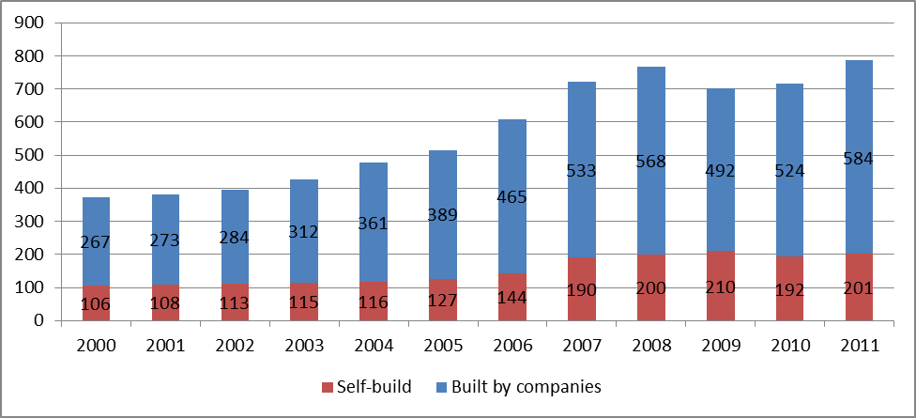
Housing Construction Scope in Russia, in 2000–2011, (housing units)

Slide 4
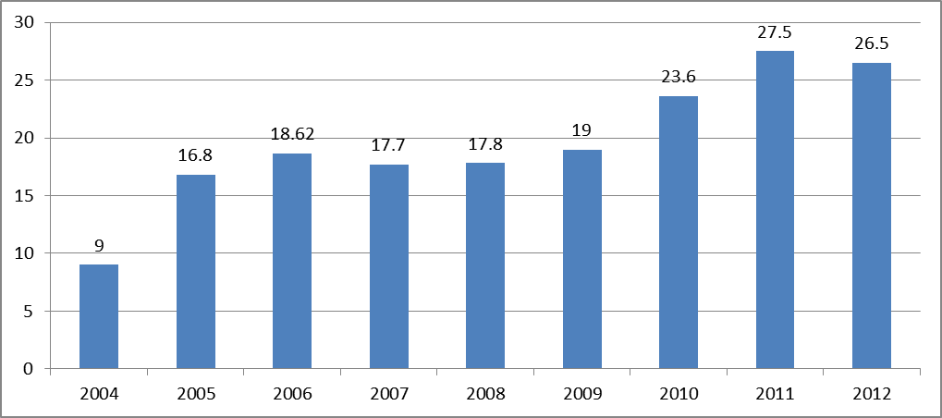
Proportion of Russian households who can afford buying residential dwellings, conforming to floor space per capita standards, with owned and borrowed funds in 2004-2012, (%)

Slide 5
Proportion of Moscow households who can afford buying residential dwellings, conforming to floor space per capita standards, with owned and borrowed funds in 2004-2012, (%)
Источник: До 2011 г. - расчеты ИЭГ по данным Росстата, АИЖК, Банка России.

Slide 6
Dynamics of average actual housing price (blue line) and average annual real income (ref line) of the population, (the year 2004 = 100%)

Slide 7
Indicators of market rent affordability in selected cities of Russia
 | Market rent fee for a two-room apartment (Rubles per month) | Monthly per capita income (Rubles per month) | Rental-price-to-income ratio (for rent of a two-room apartment) | Proportion of households who can afford renting a two-room apartment. %
St.-Petersburg | 21 513 | 27 063 | 0.26 | 38.3
Moscow Region | 19 998 | 24 926 | 0.27 | 41.5
Yekaterinburg | 24 476 | 24 314 | 0.34 | 29.9
Novosibirsk | 17 731 | 17 283 | 0.34 | 30.5
Moscow | 50 411 | 43 366 | 0.39 | 23.6

Slide 8
Housing stock structure by tenure (%)
Страна | Rental housing |  | Owner occupied | Cooperative and other
 | Social | Market
Austria | 23 | 17 | 56 | 4
Great Britain | 17 | 15 | 68 | -
Netherlands | 32 | 10 | 58 | -
Germany | 5 | 49 | 46 | -
Finland | 16 | 15 | 66 | 3
Sweden | 17 | 27 | 38 | 18
USA | 1,0 | 31,6 | 66,4 | 1,0
Russia | 13,5¹⁾ | 11,4²⁾ | 74,9³⁾ | 0,2
¹⁾ Государственный и муниципальный жилищный фонд, включая специализированный, данные на конец 2011 г.
²⁾ Включая жилищный фонд в собственности юридических лиц – 3,4 % и в собственности физических лиц – 8%
³⁾ Expert assessment
Source: Rosstat, Housing Statistics in the European Union 2010, US Census Bureau, Statistics Canada

Slide 9
Structure of rental housing in 2011
(% of total housing stock footage)
 | Total rental housing | Private rental housing owned by individuals | Private rental housing owned by legal entities | Public (state or municipal) rental housing | Of which provided under:
 |  |  |  |  | Social rental contract | Specialized housing rental contract (dormitories) | Rental contract
Russian Federation | 24,9 | 8 | 3,4 | 13,5 | 11,8 | 1,5 | 0,2
Moscow | 34,1 | 10 | 2,0 | 22,1 | 20,5 | 1,5 | 0,1

Slide 10
Distribution of Russian households by housing needs and income groups, 2010
Target group | Numer of households with acute housing need (less 13 кв. Sq. m per person) and moderate housing need (less 2 0Sq. m per person)
 | Million households |  |  | % of all such households
 | Total | Those with urgent need | Those with need | Total | Those with urgent need | Those with need
Group 1: can afford buying dwellings with mortgage loans | 4,3 | 1,2 | 3,1 | 16,3% | 4,6% | 11,8%
Group 2: can afford housing improvements (dwellings with a larger floor area) with mortgage loans | 3,8 | 1,3 | 2,5 | 14,4% | 4,9% | 9,5%
Group 3: cannot afford improving its housing conditions even with mortgage loans, though the households do not belong to a group with the lowest income | 14,0 | 5,3 | 8,7 | 53,2% | 20,2% | 33,1%
Group 4: consists of households with the lowest income | 4,2 | 2,1 | 2,1 | 16,0% | 8,0% | 8,0%
Total | 26,3 | 9,9 | 16,4 | 100% | 37,6% | 62,4%
Source: IUE expert assessment basen on both Household Budget Survey and All-Russia Population Census for 2010 data

Slide 11
KEY FINDINGS
More than 2/3 households cannot improve their housing conditions either through purchase at the market using own means and loans or through public housing allocation
Affordability of renting housing at the market is higher than that of acquiring housing with a mortgage (it varies across the cities, in Moscow the difference is twofold)
The magnitude of rental housing sector is inadequate; the sector consists of the two drastically different segments
Market rents in private rental housing in big cities is almost 10 times higher than regulated rents in public housing
Most of private rental housing is semi-legal (assessment of annual budget losses in Moscow – up to 1 billion USD)
The current legislation is not tenure-neutral
Investment projects in rental housing are not attractive for investors

Slide 12
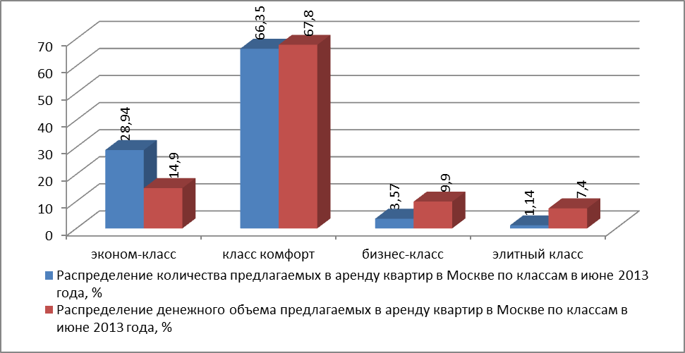
Structure of supply at Moscow private rental market,
June 2013

Slide 13
Key parameters of rental housing construction project : the case of Moscow

Slide 14
RECENT DEVELOPMENTS -1
Support of economy class (affordable) housing is identified as a state priority
Rental housing development is identified as a state priority
Agency for Housing Mortgage Lending launched a new financial product ‘Rental Housing’
Pilot projects on rental housing buildings construction are carried out in Russian regions

Slide 15
RECENT DEVELOPMENTS -2
Administrative procedures are widely used to identify private landlords but their efficiency is very low
Results of campaign on identification private lanlords in Moscow с 01.08.2012 г. по 17.07.2013 г.
Potential landlords identified | 183,4 th.
Officially checked by Ministry of Internal Affairs | 7,8 th.
Files passed to tax authorities | 3,9 th.
Expected increase of number of taxpayers | 2,0 th.
Key indicators of the Moscow voluntary registration system
 | Housing units registered
 | 2012 | 2010-2011
Under lease agreement | 1636 | 7342
Under sublease agreement | 3008 | 8652
Under free use agreement | 2778 | 12453
Total | 7422 | 28447

Slide 16
ANALYSES OF THE PRIVATE RENTAL SECTOR AS A POTENTIAL SOURCE FOR SOCIAL HOUSING

Slide 17
Types of landlords
Low-income households renting out premises in the units they occupy themselves;
Low and moderate income households who use renting as part of their income generating strategy (move to a worse housing or to suburban area)
Households who temporarily left the city;
‘Sentimental investors’ who acquired a second housing unit in ownership
Households who have plans to use the leased housing unit in the visible future for household’s needs
Individual investors – physical persons
Legal persons:
Providing housing in business or elite segments
Providing housing with rents similar to those in public housing (usually – big enterprises)

Slide 18
Risks of private landlords
Damage caused by tenant
Illegal sublettings
Contract termination without proper notice
Eviction under formal legal procedure (could take up to 2.5 years)

Slide 19
Types of tenants
Young families, single person households (children of wealthy parents);
Landlords of better housing using the difference as a source of income;
Citizens using rental housing for professional purposes (artists et al.);
Temporary migrants, including students;
Newcomers accumulating means for housing purchase;
Expats;
Businessmen and officials;
Owners of suburban housing

Slide 20
Risks of tenants
Fake brokers (information agencies)
Unexpected rent increase (including that after move-in investments are made)
Double-letting (other forms of cheating)
Deposits are not returned
Excessive landlord’s control (frequent visits)
Cutting off means of communication (telephone, Internet)

Slide 21
Legal regulation in the private rental sector
Two separate legal systems for public and private rental housing
Regulation in the Civil Code is very general. However it contain clauses which inhibit sector development:
the term of the contract cannot exceed 5 years
unrealistic terms for evictions etc.
The balance is shifted towards protection of tenant’s interests (Global Property Research)
High tax burden, inefficient tax regime
Legislation does not protect both landlord and tenant, nor does provide incentives for leaving ‘shadow zone’

Slide 22
Institutional set-up
More than ¾ transactions involve realtors
Significant share of individual brokers and information agencies who do not bear any responsibility
Informal procedures for conflict resolution and risk management
Professional realtors promote certain institutional developments at the market:
Model rental agreements
Tertiary arbitration

Slide 23
CONCLUSIONS AND PROSPECTIVES

Slide 24
Key elements of the rental housing development policy
1. ‘Legalization’ of the existing market of private landlords
2. Setting framework for construction and acquisition of multi-apartment rental buildings in both market and non-profit segments

Slide 25
Key policy choices
Establishing a new institution of non-profit housing vs modernizing inherited ‘soviet social housing’ model
New social housing providers regulated by special corporate legislation vs regulation by setting specific requirements and PPP contracts
Ensuring stability of multi-apartment rental blocks: regulation by law vs regulation by contracts

Slide 26
Priorities for legal regulation
Setting legal framework for non-profit housing and multi-apartment block
Setting legal requirements for specialized non-profit landlords
Strengthening regulation of landlord-tenant relations
Special regulation for land allocation for construction of multi-apartment rental blocks
Changing the system of landlord’s taxation
Stregthening responsibility for non-compliance with the law

Slide 27
‘Legalization’ of the existing market of private landlords
Setting incentives (including tax ones) for compliance with the law
Increasing attractiveness of legal rent contract
Support administrative control by control of those whose interests may be affected (neighbors)
Mandatory state registration of rent contracts with more that 1 year term

Slide 28
Special regulation for land allocation for construction of multi-apartment rental blocks
1. Privileged access to land plots
2. Legal regulation of special auctions for land plot allocation for housing construction
- special auctions with target use of land plot for multi-apartment block construction
special auctions with start price below the market level (for non-profit housing)
special auctions where the subject is the price of future rent contract (for non-profit housing)
special auctions where the subject is the sales price of the built multi-apartment block to a specialized non-profit landlord

Slide 29
Model 1
Construction of multi-apartment rental blocks with use of collective investments
Other investors
Mutual Real Estate Investment Fund
Investor
VEB
Lender
Construction loan
Builder/Owner
Management company
Multi-apartment rental block, market segment

Slide 30

Model 2
Projects supported with a mortgage
Selling bonds fitting AHML standards
Lender of the project
AHML
Purchase of MBS using the Pension fund means
Mortgage loan for multi-apartment block puchase
Guarantee of providing eligible tenant
VEB
Borrower
Purchase of multi-apartment block
Regional or local authority, Employer
Tenants’ allowances
Rant agreement

Slide 31
Model 3
Model of non-profit rental housing development within state or municipal housing stock
Lender
Munucipality
Long-term lending
Construction financed from the budget
Multi-apartment rental block, non-profit segment
Paying back (rent)

Slide 32
Модель 4
Model of non-profit rental housing development within by specialized landlords
Means of founders
Specialized landlords
Lender
Long-term lending
(Model 2 mechanism could be used)
Budgets or means of enterprises
Payback of the loan ()
Multi-apartment rental block, non-profit segment

