Slide 1
Rental tenures in post-socialist countries
Slovenia (Serbia and Croatia)
As. prof. Špelca Mežnar
ISSBS, Celje
spelca.meznar@mfdps.si

Slide 2
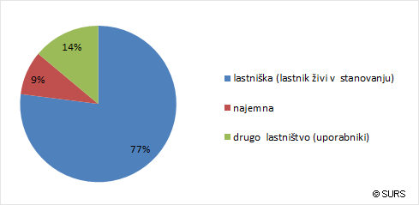
Slovenia tenure structure
77 % home owners
9 % rentals
Source: SORS, 2011 (http://www.stat.si/novica_prikazi.aspx?id=4420)

Slide 3
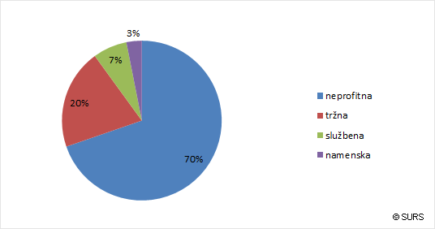
Slovenia
Types of rental tenures
The 2003 Housing Act -> Article 83:
Non-profit – 70% (6,5%)
Market - 20% (1,5%)
Employment-based
Purpose-based
Source: SORS, 2011 (http://www.stat.si/novica_prikazi.aspx?id=4420)

Slide 4
Slovenia Relevant legislation
2003 Housing Act (HA-1) – profit & non-profit rentals
2001 Code of Obligations
Rules on renting non-profit apartments
Decree on the methodology of determination of rents for non-profit housing and the criteria and procedure for the implementation of subsidised rents
Rules on standards for the maintenance of apartment buildings and apartments

Slide 5
CONTRACT
HA: a written contract
Market rentals: often without a contract
HA: illegal use if contract not concluded or has expired
open-ended v. limited in time
Non-profit rentals open-ended only
Market rentals: limited in time
Minimum provisions
description, location and identification number of the dwelling
communal equipment
manner of use
information on the landlord and tenant
reasons for termination
type of rental relation
mutual obligations and maintenance of the dwelling and the building
rent price and running costs
period of tenancy
manner in which the dwelling is handed over

Slide 6
Rent REGULATION, subsidies (Slovenia)
No state regulation of market rentals
Rent in non-profit sector -> special methodology from the Decree on the methodology of determination of rents for non-profit housing and the criteria and procedure for the implementation of subsidized rents (cca. 180 EUR for 55m²); costs are paid separately
Subsidies: for both market and non-profit (0.1-80% of the rent)

Slide 7
Intermediary tenures (Slovenia)
Introduced in 2013 as an experiment:
A model of shared ownership between the municipality of Ljubljana and applicants (natural persons) -> similar conditions and requirement as for the non-profit rentals
Applicant must find a dwelling on the market
Tenant pays 60%, MOL pays 40%
Applicant pays a monthly “compensation for use”, amounting to a non-profit rent, for 15 years

Slide 8
Termination - market RENTALS
TENANT:
at any time, in writing, no reasons, 90 days termination period or shorter (if agreed)
LANDLORD:
11 culpable reasons (not paying the rent etc) – the reasons may be expanded by agreement
For other (non culpable reasons) – only if the landlord provides tenant with an adequate appartment
Applies also to „justified“ reasons, such as landlord‘s own need to use the apartment
Case law: the termination has to be made by a court claim

Slide 9
Termination non-profit RENTALS
Tenant – see market rentals
The landlord: only due to 12 culpable reasons
Exception: the tenant’s financial situation deteriorated and he initialized the procedure for obtaining either subsidy or financial help

Slide 10
CROAtia
Types of rental tenures
Market rentals
Protected tenants (former housing rights owners) with protected rent
Social rentals (poor people, war veterans) with protected rent (State Decree)
Public rentals (young families)– rent between market and protected - municipalities
POS programme rentals (the new rent-to-buy sheme)

Slide 11
serbia

Slide 12
Serbia
Types of rental tenures
Public (social) + Housing in Supportive Environment
Market
“Protected” tenants

Slide 13
Housing in Supportive Environment (Serbia)
Consists of one multi-apartment building with several individual units and a common area-> all but 1 unit are allocated to households, which need assistance with certain tasks; 1 is allocated to a household, which is capable of assisting others; all of them are socially endangered and less well-off citizens
E.g. the members of households in need of assistance are older, disabled, ill, single-parents IDPs, refugees, Roma, etc., while the assisting household is younger and is in a way employed by the social assistance system

