Slide 1
Public renting through agencies in Luxembourg
Marta dos Santos Silva
ZERP
Bremen, Germany
Workshop
Emerging private rental sector in accession and transition countries:
is there an option for the new social rental agencies?
- Western European perspectives -
13 September 2013
Budapest

Slide 2
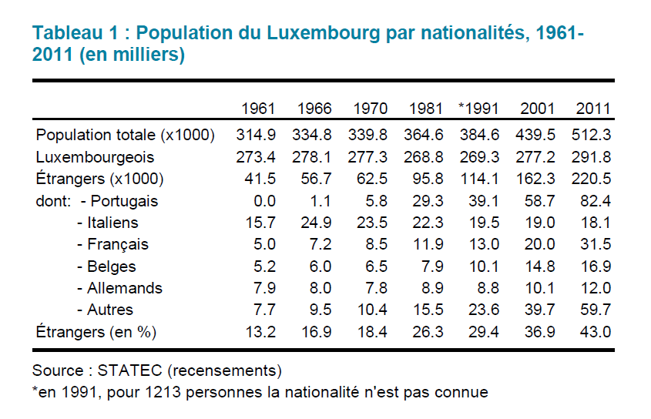
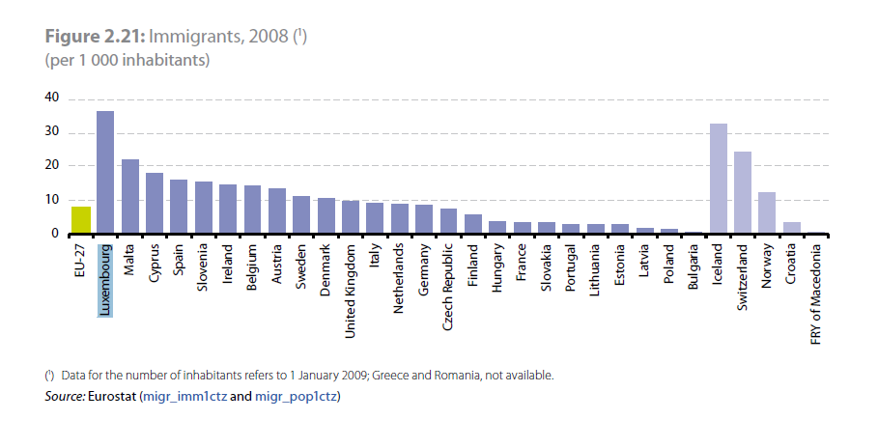
population

Slide 3
Housing tenures
Home ownership | Renting 29% |  | Intermediate tenure / Other | Total
 | Renting with a public task | Renting without a public task
67% | 7%* | 93% | 4% | 100%**
* 2% of the total housing stock in the country
** 130,091 dwellings (2011)

Slide 4
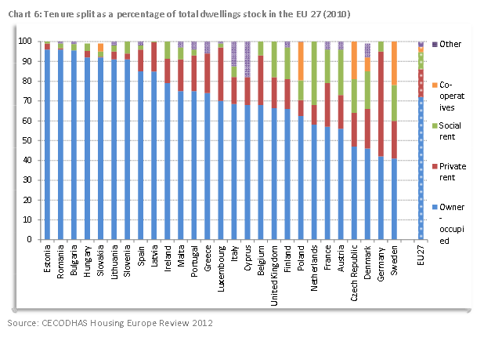
Housing tenures

Slide 5
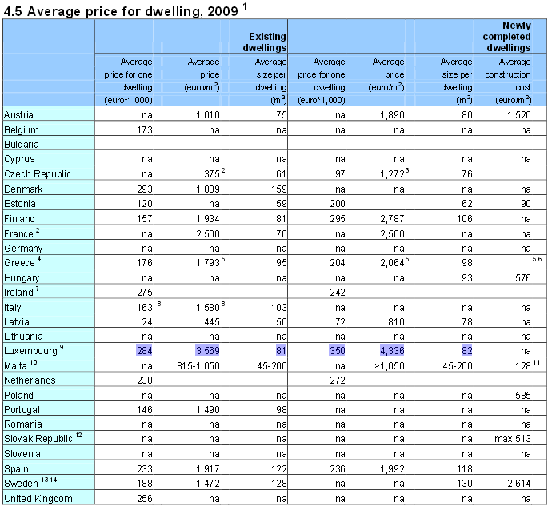
Average Price for Dwelling
Source: Housing Statistics in the European Union 2010 (emphasis added)

Slide 6
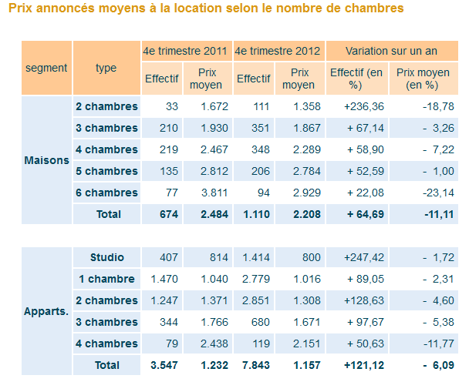
Average rent for Dwelling
Source: Observatoire de l‘Habitat

Slide 7
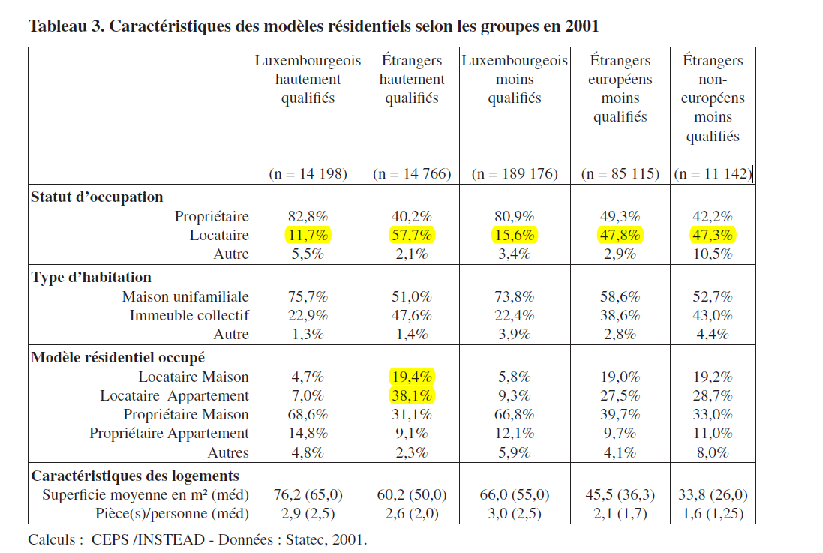
Profile of tenants
Source: LORD & GERBER, 2009, p. 97 (emphasis added)

Slide 8
Profile of owners
Petits bailleurs (own one or two dwellings, usually inherited or acquired during working life)
Financement primarily through mortgage loans
Public financial aid in capital or interest (financial assistance for construction, complement of financial assistance for architect or engineer consultant fees, and homebuyer savings plan general grant)
Lack of financial capacity generates slum landlordism

Slide 9
Social housing
Social housing
Low cost housing provided both for rent and for sale to people with low income
Subsidized by State (70-100% of construction price)
Public developers:
Fonds pour le development du logement et l’habitat (Fonds du Logement): 1703 dwellings
Société Nationale des Habitations à Bon Marché: 174 constructions

Slide 10
Access to Social housing
Decentralized allocation: municipalities
Access to the social housing sector:
Households with income lower than a specific ceiling
Applicants cannot be owners or usufructuaries of another dwelling nor have a right to inhabit another dwelling (Fonds du Logement)
Applicants with modest income and experiencing a difficult housing situation are prioritized (S.N.H.B.M.)
Homeless (personnes sans domicile) and people who live in dwellings in poor condition can be granted a dwelling with a public task only if they are accompanied by a representative from an association.

Slide 11
Vacant dwellings
Vacant dwellings
Unoccupied dwelling units
37,448 units = 7.5% of the rental stock (61% apartments; 39% single-family dwellings) Census, 2001
One third in the city of Luxembourg
Allegations of speculative retention of sites by land owners - Government intends to introduce progressive land tax to penalize it
Tax imposed as sanction to owners in Esch-sur-Alzette, Diekirch and Beckerich

Slide 12
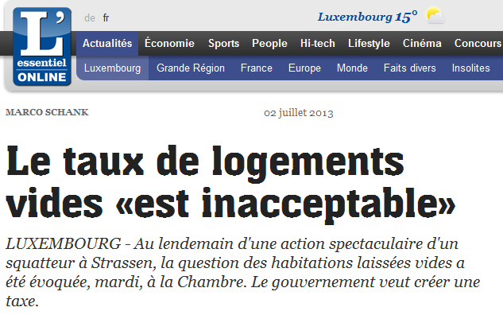
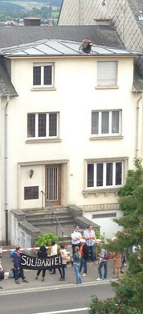

Vacant dweelings & squatting

Slide 13
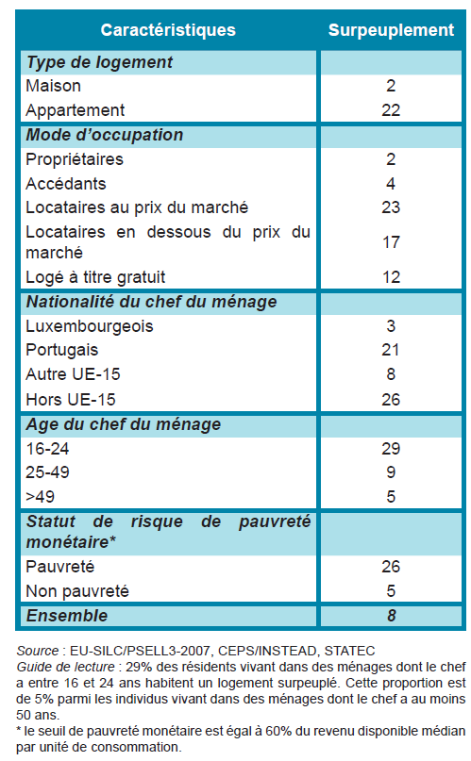
habitability

Slide 14
Housing market
DEMAND has been increasing:
Demographic growth & positive net migration
Increase of small households
Low interest rates for mortgage loans
Uninterrupted increase in income
SUPPLY has been decreasing:
Scarcity of land for construction
Insufficient production of housing
Energy and ecological profile of housing and habitat

Slide 15
state measures
This imbalance has been a main concern of policy makers in Luxembourg since the 1970s.
The government has been approving financial support measures for construction upon the initiative of public and private promoters, municipalities, and even individuals:
Pacte logement
Paquet logement (construction of 9000 dwellings)
Taxation benefits
Progressive land tax to penalize the speculative retention of sites by land owners (projected)

Slide 16
hOUSING SITUATION in luxembourg
Real Estate Chamber
Need for 15,000 rental low-cost dwellings (4.5 billion EUR)
Financial state aid insufficient to overcome the lack of affordable, adequate dwellings
Advocation of the involvement of the private sector in the construction of low-cost housing
Projection of National Company of Urban Development (Société nationale développement urbain) in the Paquet Logement
Single legal entity gathering different housing actors, know-how and financial resources
Model similar to a private joint stock company
The idea was abandoned by the Housing Ministry (less effective than keeping the different public housing providers as autonomous entities)

Slide 17
IN SHORT
MAIN CHALLENGES in the Luxembourgish housing sector:
Growing population
Clear predominance of owner-occupied dwellings
Mismatch between quality of housing and level of rents
Exiguous social rental market
Large number of vacant dwellings
Disparity of housing conditions among households

Slide 18
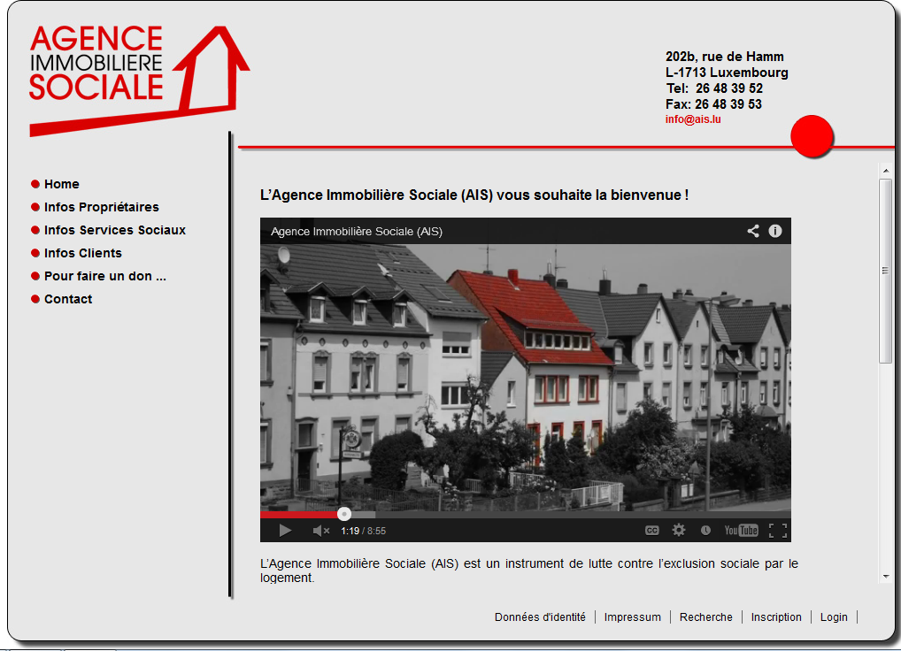
Agence immobilière sociale (AIS)

Slide 19
Creation and aims
Non profit organization (association sans but lucrative) created in 2009
Rents dwellings from the private rental market to sublet at an affordable rent to poor and vulnerable households.
Covers Grand Duchy of Luxembourg
Aims at:
Supporting vulnerable households
Providing greater security of tenure
Promoting finantial autonomy of tenants
Fighting social exclusion
Offering deprived people the opportunity of taking a first step into a better life.

Slide 20
financement
Annual cost: 25.000 euros. 50% costs covered by European funds and 50% co-financed by national funds
Funded by the Fondation pour l‘Accès au Logement (public utility organization)
Ministry of Family and Solidarity assumes the personnel and administrative costs
Housing Ministry assumes the costs concerning the management of rental dwellings

Slide 21
Application
Elegible applicants must prove:
Have a problem of housing (too small, bad conditions, notification of eviction, menace of expulsion, temporary accomodation in homeless hostel or temporary housing; difficult situation following divorce)
Income lower than ceiling defined according to the compositon of household
Not owners of dwellings in Luxembourg or abroad
Valid residence permit
Member healthcare service
Engage to benefit from social adapted support and actively colaborate in the project

Slide 22
Procedure
Applicant contacts social services, who introduces application in name of tenant
AIS contacts private landlords and offers to rent their property for a negotiated rent
Landlord agrees in a lower rent to be paid by the tenant in exchange for guarantee of payment of rent, maintenance of the physical quality of the housing and ensurance of practicalities of letting
AIS chooses the tenant and carries out administrative and management tasks: making a property inventory, registering the rental contract, processing deposits, collecting rent, arranging fire insurance and organizing repairs and maintenance

Slide 23
Procedure
AIS elaborates an availability contract (contrat de mise en disposition) and a project of social inclusion with the agreement applicant and scial services
AIS collaborates with social offices and social services: AIS staff visits the tenant every three months to check whether tenant is fulfiling the contract
Refusal of collaboration = termination of the contract

Slide 24
Advantages
Tenant: provision of a dwelling for a smaller price than in the private rental market; security of tenure (three years)
Landlord: rental of difficult-to-let dwellings; guaranteed and timely payment of rent (also when dwelling stays vacant); continuity of tenancy; quality of dwelling; freedom from letting inconveniences (older landlords); use for unused dwelling
Market: less vacant dwellings, then less tendency of rents to increase

Slide 25
results
October 2009-January 2010: provided shelter for 65 people, including 36 children
2010: expanded due to high demand of landlords and tenants
End 2010: provided 60 dwellings (171 people, including 94 children
At the moment: 111 dwellings; about 4 to 5 households are being housed each month
Overall the project has been sucessful: many accomodated families have found a place in the private rental market withing the three years that their contract lasted.

Slide 26
Current status
So far, the AIS has the monopoly of this rental activity.
The housing crisis has been encouraging the development of this model.
The AIS does not have a legal status.
The model of the AIS in its current form is very expensive, namely due to personnel costs.
Municipalities and inter-municipal bodies are available to involve themselves in projects aimed at making available to their citizens finantially approachable rental housing.

Slide 27
„GESTION LOCATIVE SOCIAL“ social rental management
Draft Law concerning the promotion of housing and habitat (Projet de loi relative à la promotion du logement et de l‘habitat) – April 2013
„Section 5. Participation in the operating costs of social rental management bodies
Art. 46: (1) The minister is authorised to provide a grant for the operating costs of social rental management bodies.
The social rental management is an aid instrument through which bodies working in the housing sector rent dwellings from the private market stock and make them available to households in situation of exclusion connected to housing or households with low income.
Social rental management bodies consist of bodies working in the housing sector and exercising an activity of social rental management, both at the municipal level, as municipal unions, fondations or non-profit associations.
(2) The maximum amount of the financial grant is limited to 100 EUR/month per household. (…)“

Slide 28
„Social rental management bodies“
Target population includes two main types of categories of people:
Low-income households, with difficulties in renting in the national private rental market and where the effort rate for the payment of rent is higher than 33% of their available net income;
The people envisaged by the European typology of exclusion connected to housing (ETHOS), developed in 2007 by FEANTSA.

Slide 29
Preliminary conclusions
AIS can be an effective instrument to overcome growing demand and insufficient supply of recent rental housing on the Luxembourgian market.
In a context of overall economic and finantial crisis the process of using vacant dwellings of the private market and chanelling them into social housing de facto may „relieve“ public entities of the unberable weight of meeting increasing demand.
The role that AIS has been available to play in the maintenance of dwellings can be a way of renovating a progressively deteriorated housing stock and of ensuring energetic efficiency

Slide 30
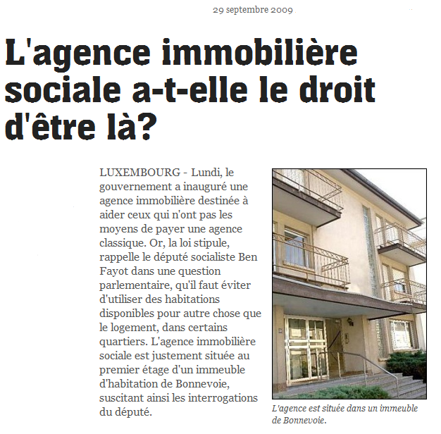
No Right to „housing“ for the ais?

Slide 31
THANK YOU
Marta dos Santos Silva
ZERP, University of Bremen, Germany
marta.silva@zerp.uni-bremen.de
www.tenlaw.uni-bremen.de

