Slide 1
Overview of the regulation and the management of housing policies
(Opportunities to use private rental stock for social purpose?)
ESTONIA
Ave Hussar, mag iur
University of Tartu
Faculty of Law
Emerging Private Rental Sector in Accession and Transition Countries:
Is there an Option for Social Rental Agencies?
Budapest, September 12-14, 2013

Slide 2
Plan of the presentation
Development of the housing sector after the transition
New development in social housing sector
The analyses of the private rental sector
Conclusion: the opportunities to use private rental stock for social purpose?

Slide 3
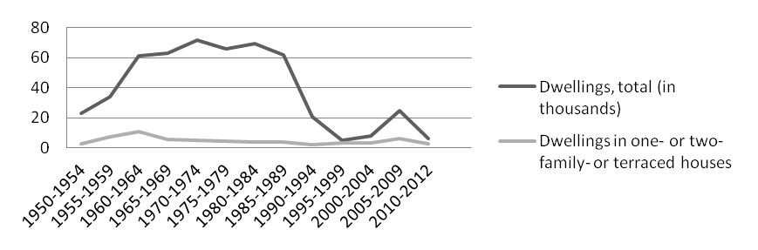
Development of the housing sector since 1992
Common inheritance
Intensive apartment building 1960-1980
Limited private ownership of (small) residential houses
Dwelling construction dynamics from 1950 to 2012 in Estonia
No. of dwellings per 1000 inhabitants EE - 412, LV - 369, LT - 312 (1990)
Still shortage 5 % by 1989 (Estonia)

Slide 4
1. Development of the housing sector since 1992
Tenants of restituted houses
concerned 47,200 tenants, i.e 3 % of the population
regulated rent periods until 2007;
rent control until 2004;
municipal housing options
problem “solved” in Tallinn by 2009
Privatised ownership
mainly flats;
mainly non-Estonian families.

Slide 5
Development of the housing sector since 1992
Demographic context
Number of permanent residents in Estonia - 17,3% from 1,565 million to 1,294 million (1989-2011); (- 5,5% in period of 2000-2011);
No of households 599,8 thousands (2011) (575,3 thousands in 2000);
Although the number of permanent residents has decreased by more than 75,000 persons compared to 2000, in 2011 the number of households has grown by 3%. This has brought along the decrease in the size of the average household from 2.33 members to 2.13 members.

Slide 6
Development of the housing sector since 1992
Housing statistics (2011 National Census)
No of conventional dwellings - 649 746 (+ 5.2% since 2000)
Unoccupied dwellings: 14,4% of dwellings in total (in urban areas: 11,2 %, in rural areas: 21,1%);
Average number of rooms per inhabitant: 1,24 (in urban areas: 1,18, in rural areas:1,37);
New construction (1991 and later) – 14,8% of total dwellings;
Number of households (13 %) lacking elementary sanitary conditions.

Slide 7
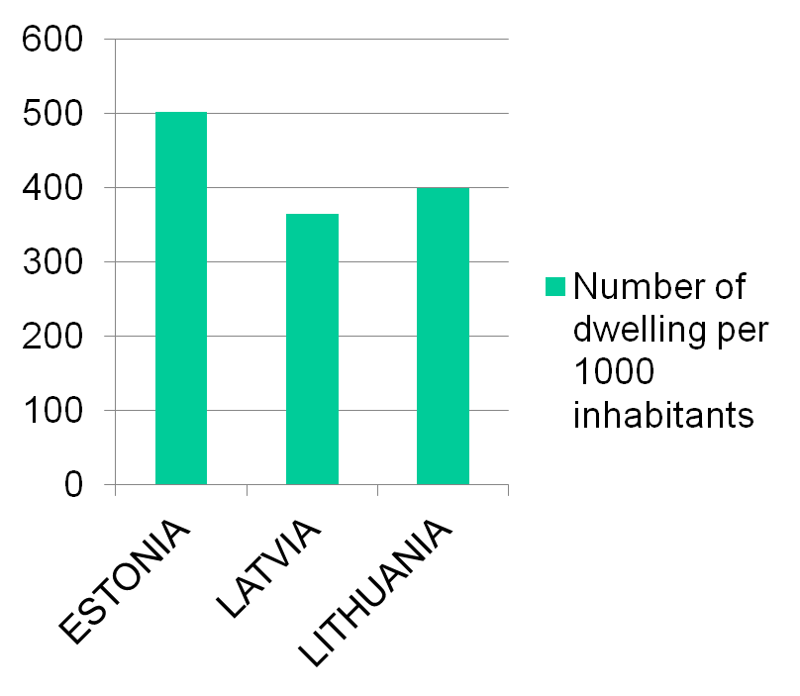
Number of dwellings per 1000 inhabitants Source: http://www.housingeurope.eu/www.housingeurope.eu/uploads/file_/HER%202012%20EN%20web2_1.pdf; Statistics Estonia
EE - 502 (2011)
LV – 461 (2009)
LT – 400 (2011)

Slide 8
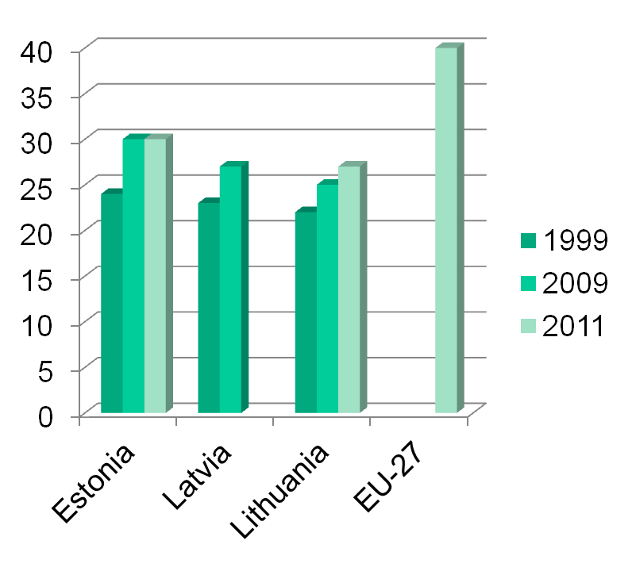
Useful floor area of dwellings per capita, in m² (1999-2011) Source: National statistics, http://www.seb.ee/sites/default/files/web/files/uudised/baltic_household_outlook_oct_2012.pdf
EE - 30,1 m² (2011)
LV – 27,2 m² (2009)
LT – 25,5 m² (2011)
EU – ca 40 m²

Slide 9
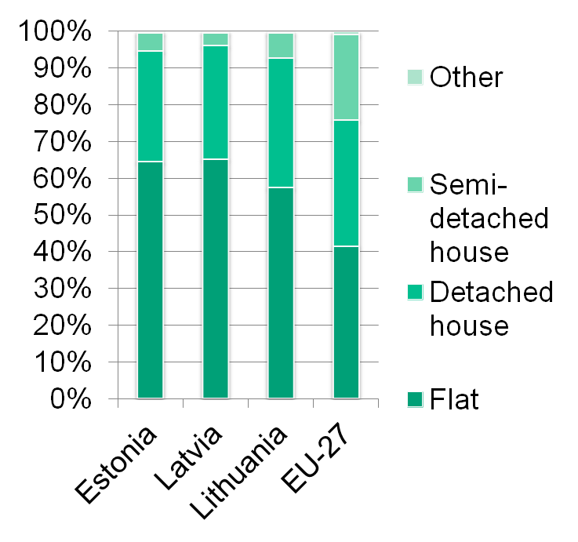
Distribution of population by dwelling type, 2011 Source: Eurostat (online data code: ilc_lvho01)
Live in flats:
EE - 64,5 %
LV – 65,4 %
LT – 57 %
EU – 41,8 %

Slide 10
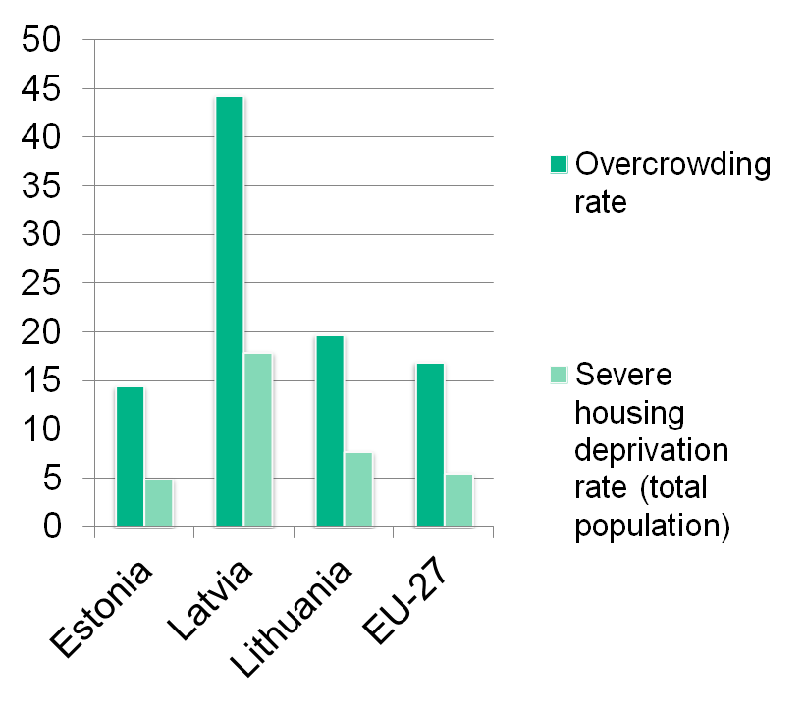
Condition of housing stock (2011) Source: Eurostat (online data code: ilc_lvho01)
Overcrowding rate (% of total population)
EE – 14,4
LV – 44,4
LT – 19,7
EU – 16,9
Severe housing deprivation rate (% of total population)
EE – 4,9
LV – 17,9
LT – 7,7
EU – 5,5

Slide 11
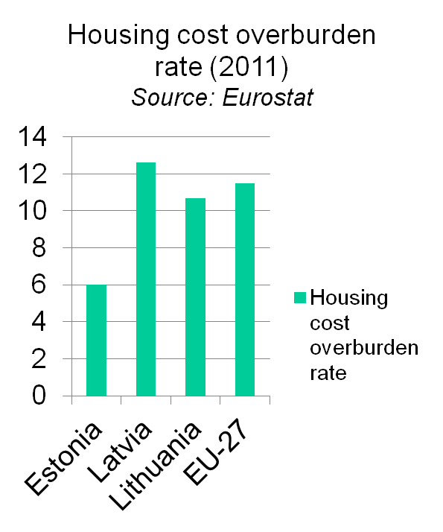
Economic context
Household expenditure:
Estonia (2010) - 19 %
Latvia (2011) - 16,6 %
Lithuania (2009) – 15,9 %
EU 27 (2009) – 22,9 %
Ratio of private loans to GDP: Estonia: 44 %;
Latvia: 37 %;
Lithuania: 25 %.
Proportion of housing loans in the overall portfolios: EE - 84 %, LV - 81 %, LT - 79 %.

Slide 12
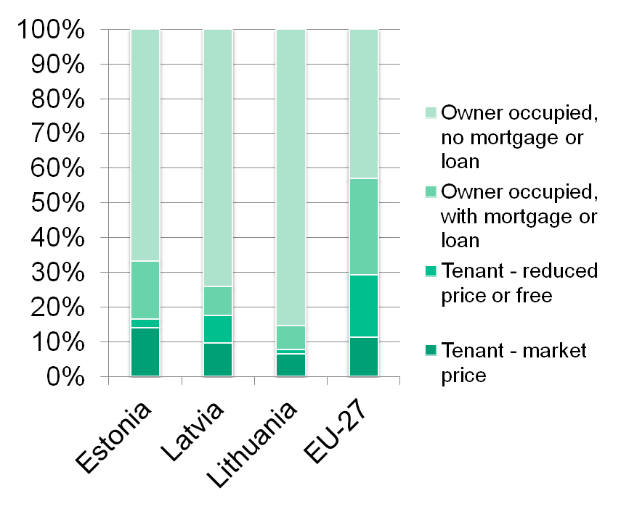
Market share of different types of tenure (2011) Source: Eurostat (online data code: ilc_lvho02) http://www.seb.ee/sites/default/files/web/files/uudised/baltic_household_outlook_oct_2012.pdf
Owner occupied (% of the population):
EE – 85,5 %
LV – 84,1 %
LT – 93,1 %
EU – 70,7 %
Private ownership of housing stock (% of housing stock):
EE – 97 %
LV – 97 %
LT – 89 %

Slide 13
Tenure structure
Home ownership: 85 % (in urban areas: 82 %, in rural areas: 87 %) (esitmation)
Rental bases tenures: 15 % :
Private rental tenure: 11 %;
Public rental tenure: 4 %.
Social rental housing (Social Welfare Act Art. 14)
disabled persons, persons and families with social needs (low income etc.)
Other public housing
housing for persons from restituted homes (Principles of Ownership Reform Act, Art. 12, para 5)
other target groups determined by municipality (or state).

Slide 14
National housing policy
Constitution – no positive right to housing, but:
Art 28. Everyone is entitled to protection of his or her health.
Every citizen of Estonia is entitled to government assistance in the case of old age, incapacity for work, loss of provider, or need.
Families with a large number of children as well as people with disabilities enjoy special care of the national government and of local authorities.
Social Welfare Act, Art 14 Housing services:
Local government bodies are required to provide dwellings for persons or families who are unable or incapable of securing housing for themselves or their families and to create, if necessary, the opportunity to lease social housing.

Slide 15
National housing policy
The Estonian Housing Development Plan for 2003-2008
(Ministry of Economic Affairs and Communications)
Expanding the municipally owned housing stock
Tenants of restituted houses
New labour arrivals
Socially vulnerable groups
State guarantees to housing loans of young families, young specialists and tenants of houses returned to their legitimate owners
Reconstruction of apartment buildings and the relevant awareness raising
Allocation of subsistence benefits
Use of social housing

Slide 16
National housing policy
The Estonian National Housing Development Plan for 2008-2013
Problems admitted:
Housing is not accessible to every resident in Estonia.
/…/ about 3 000 – 3 500 homeless persons in Estonia (2 000 in Tallinn). Every year ca 300 children without parental care become adults and need housing; /…/. Ex-convicts also require housing (around 2000). The 65 900 retired households, as well as students with economic difficulties would be the potential tenants of municipally owned housing.
The demand exceeds the supply in Tallinn and in all major cities. Across Estonia the local governments would need an additional 6 000 municipal and social dwellings.
Limited number of apartments adapted for person with special needs.

Slide 17
National housing policy
The Estonian National Housing Development Plan for 2008-2013
Objective: to ensure access to suitable and affordable housing for everyone
Target group: Low income households: large families, young families and young specialists, children and adolescents without parental care, disabled persons, the elderly, students, ex-convicts and probationers and also local governments.
Measures:
Imporving access to dwellings(for persons with special needs)
Support to adapting the housing to meet special needs.
Production of guidelines for technical solutions aimed at creating access to buildings.
Improving possibiitied for acquisition of housing
Deduction of housing loan interest paid from taxable income - ca 20 million euros/ 100 000 applicants yearly
State guarantees to housing loans (since year 2000, 23 184 households (young families, young specialist, tenants of restituted houses) have benefited)
Improving housing conditions
Ensuring compensation of housing cost to persons with coping difficulities
Subsistance benefit
Improving the legal environment and increasing admnistrative capacity

Slide 18
National housing policy
The Estonian National Housing Development Plan for 2008-2013 (cont)
Measure: Imporving housing conditions
Activities:
Home support for large families – about 2,2 million euros /250 families per year
Support for increasing municipally owned housing stock –
The state assists the construction of a rental buildings, the purchase of rental flats, or the renovation of existing building or flat(s), by covering 50% of the price of purchase, construction or renovation. In reality: measure not implemented during the period of 2008-2013
Offering reverse mortgage for the elderly
Mapping the rental housing stock
Support for PPP projects of the rental housing stock

Slide 19
National housing policy
Subsistance benefit
76.70 euros a month for a person living alone or firstborn member of a family and 61.36 euros for the second and each succeeding member of a family.
No of persons receiving the benefit (as from the total population) 1,7 in 2007 to 3,0 % in 2012.
Example of Tartu: 5,50 euro/1 m2 in a month vs average market rent august 2013 – 7,1 euro; (Tallinn 6,40 euros vs 8,2 euros)

Slide 20
Local housing policy - Tallinn
No of inhabitants - 427 894 (growing tendency 2008-2013), i.e. 31% of the Estonian population.
The residential housing stock owned by the city has currently 4,200 dwellings of which ca 3,500 are suitable for living. (i.e. 2% of the total residential fund in the city).
The only municipality that have implemented special residential housing programs:
– Residential building program “5000 dwellings to Tallinn” (2002 – 2008). Target group: forced tenants, persons urgently needing dwelling, incl. PPP pilot project (680 flats).
– II residential building program (2008–2011). Target group - municipal dwellings for employees of institutions administrated by the city, young families, incl. PPP project (1215 flats).

Slide 21
Tallinn (cont.), as a result:

Slide 22
New developments
Development plan as of 2013 - …?
National housing policy as a
part of energy saving policy;
part of social security policy;
subject to political will.
It is generally acknowledged that there is need
to support labor force mobility by providing more rental dwellings,
and make rental market more transparent.

Slide 23
New developments
Development plan of Tallinn 2014-2027
Vision: in 2027 the percentage of municipally owned rental housing stock for Tallinn constitutes 7.5% of the total housing stock.
One of the sub-objectives: Purposeful housing policy of the city and guaranteeing that those needing help will obtain housing from the municipal residential building fund:
Performance indicators | 2014 | 2015 | 2016 | 2017
Number of dwellings in complete buildings belonging to the city | 2321 | 2321 | 2321 | 2421
Number of dwellings taken into use from private sector | 1895 | 1895 | 1895 | 1895
Number of social accommodation units | 6 | 6 | 6 | 6

Slide 24
Private rental sector
The supply side
Mainly half-professional or „accidental“ landlords; almost no institutional landlords.
Rental business is generally profitable only while the existing (usually restituted or privatized) dwelling does not need major repair works or reconstruction.
As to the new dwellings – family houses or high-quality apartments – properties are often let for rental with the prospective of the owners taking the dwelling back into their own use and/or depending on market conditions (rent covers loan payments while the resale prices do not cover the outstanding loan).
Problems connected with personal income tax (21 %)

Slide 25
3. Private rental sector
The demand side
Which social groups should be covered by social housing services. Definition “people in need” is more than arbitrary.
Home-ownership is still an ideal for most young families, but lack of financial means for initial payment for mortgage loan and the need for mobility may postpone the decision.
Irrespective of family status or age group, the perceived need for renting apartment from the municipality can be observed as an economical inevitability, on the other hand as a housing relationship which gives the feel of security.
Subsistance benefit

Slide 26
3. Private rental sector
The demand side
Measures in favor of home ownership:
Guarantees
Tax deducation of mortgage interest rate
From 2013 the home owner's land tax exemption ( 0.15/0,2 hectares)

Slide 27
3. Private rental sector
Operation of the private rental sector
Commercial rental regulation – balanced? However, market conditions may not respond to the need of the potential renter: flexibility of contract terms, possibility to register the dwelling as a permanent place of residence, size of the dwelling, lack of amenities.
Informal risk management - selection of the tenant, (unlawful) discrimination, leaving contracts unformalized or forcing term contract.
Examples of formal risk management:
Contract – no format requirement. However, …
Registration not required, but ...
Security deposit in the amount of up to three months' rent can be agreed.
Increase in rent is possible only …
Pledge in the movables
Upon the termination of the contract (formalized or factual), the former tenant can not be evicted without a court decision.

Slide 28
Conclusion: opportunities to use private rental stock for social purpose
Experience with PPP so far?
Interplay with subsistence welfare benefit system?
Construction costs and matters of efficient volume?
Matter of quality and structural problems rather than problem of quantity?
Is there a necessity?
Is there political will?

Slide 29
Thank you!

