Slide 1
Budapest September 12-14
Social housing and the rental sector
Sven Bergenstråhle
President
International Union of Tenants
svenbergen@telia.com

Slide 2
I am going to talk about
The right to housing
A tenure neutral policy
The importance of a substantial rental sector
The need for social housing
Social housing in owner-occupied estates
What should an agreement include?

Slide 3
The right to housing
A fundamental right
UN Universal Declaration of Human Rights, article 25
The European Social Charter, revised, article 31
Housing is a key anchor of human development (Housing Forum Europe & Central Asia 2013)
”The paradigm of housing as a financial asset negatively affects housing conditions….. We are witnessing the failure of this paradigm”. Raquel Rolnik (UN Special rapporteur)

Slide 4
Rental housing in a changing society
Rental housing has a great future if laws and terms are fair for the tenants.
We live in a changing society, where new jobs appear and industrial jobs disappear. Nothing is secure.
Owner-occupiers who want to move have to find a buyer, and it can be difficult. The transactions costs are high.
For a tenant is it easy to move. The transaction costs are low.
Unemployed don’t have money to buy a dwelling – it will take a long time after they have got a job
But hopefully there is affordable rental housing available
Sven Bergenstråhle

Slide 5
A tenure neutral policy
Tenure neutral housing policies will contribute to more stable housing markets and counteract housing price bubbles(Prof. H. Priemus and Prof. M. Elsinga of Delft University, C. André, OECD and several other researchers)
Large subsidies and subprime loans to house-owners together with an excessive and unregulated financial market have caused the present financial crises.
The choice whether to rent or to own your home should be possible, and a right, in all countries.
The rental market should consist of at least 1/3 of the whole housing market
Sven Bergenstråhle

Slide 6
Problems with a high rate of homeowners
If the level of homeownership is too high in a country, this may seriously hamper the spatial flexibility of the labour force and the economic growth.
Low income owners cannot afford maintenance and repairs.
Physical deterioration, poor maintenance, serious technical deficiencies and high energy costs are too common
Many households have in fact negative assets
Lack of necessary financial, legal and organisational conditions in many countries (house-owner associations)

Slide 7
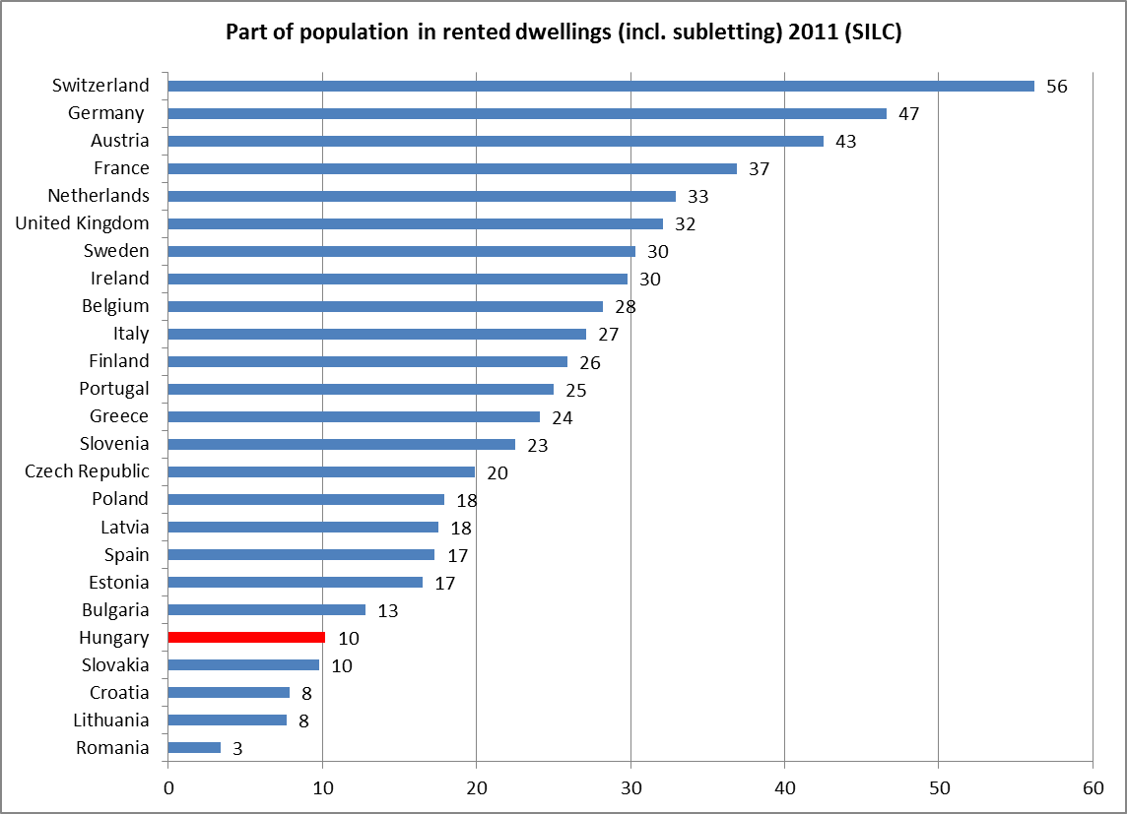

Slide 8
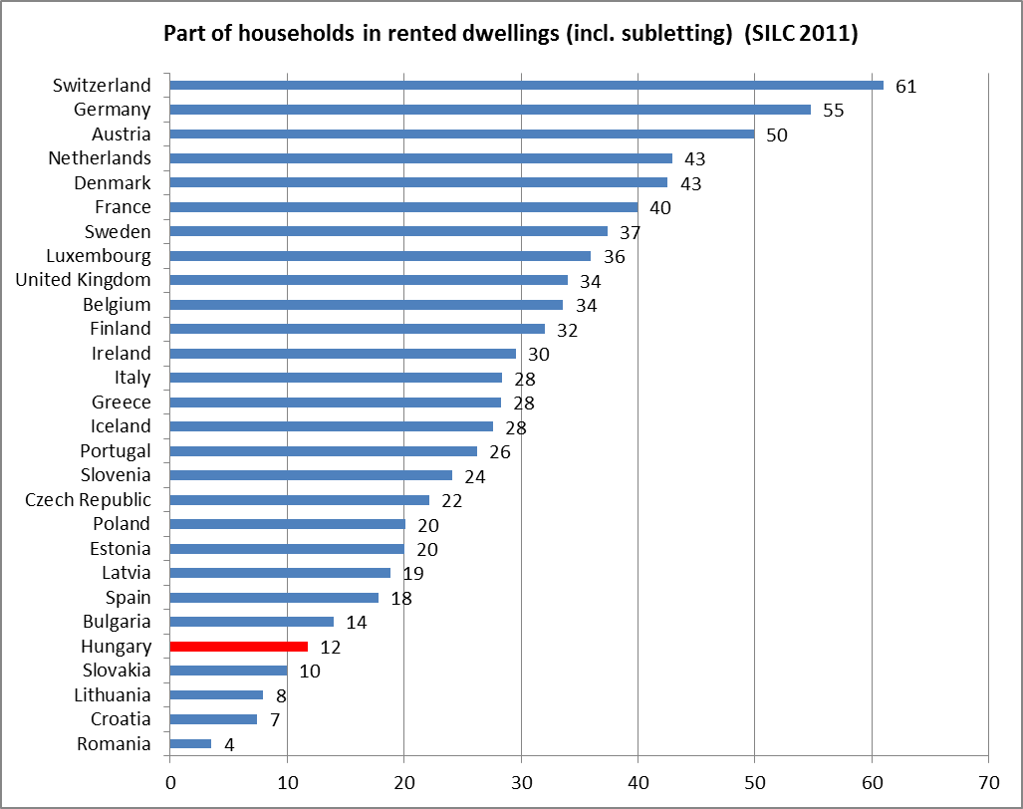

Slide 9
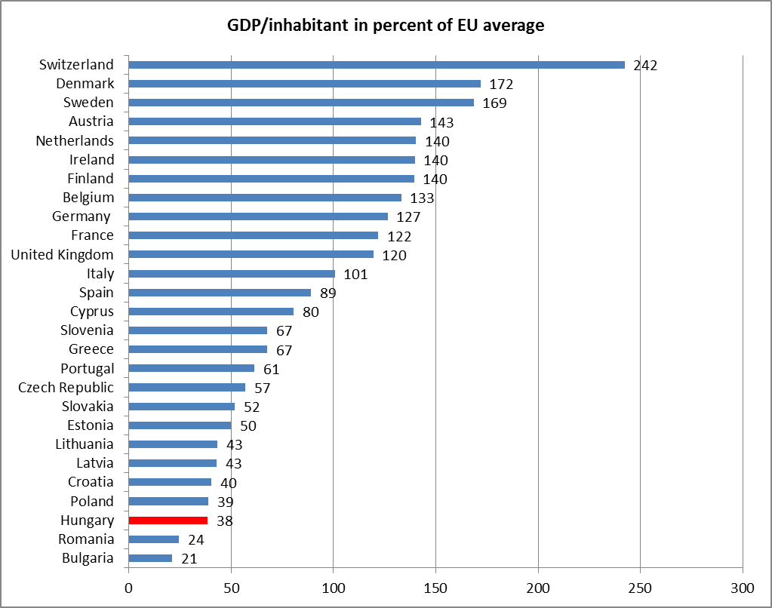

Slide 10
Every country has a rental market
But too often informal, non-existent in official statistics, unregulated, without secure tenancy and dominated by sub-letting
The laws are often written to take care of only the owner’s interests.
The owners don’t want written tenancy agreements – to avoid taxes
No security of tenure, no regulations

Slide 11
A transparent and fair rental market
Need for a well-functioning, transparent rental market, with a balance of interests between landlords and tenants.
The lease agreements should reflect these necessary conditions.
The rent law should define tenants rights and obligations and give protection from unfair evictions, unfair notices and unfair rent increases
A sale should not break the tenancy agreement
A neutral court/rental housing tribunal is necessary
The right for tenants to organize
Without this legal framework there will be no investments in rental housing
Sven Bergenstråhle

Slide 12
The need of social housing/subsidies
The market alone cannot solve the housing problems for many e.g.
Young households
Certain ethnic groups
Low income households
Disabled households in need of care
Housing subsidies are necessary but should not be able to capitalize. The rent or the price for a dwelling should be lowered in an amount that reflects the value of the subsidy.
We need social housing, housing allowances and other forms of adapted housing

Slide 13
The target group of social housing important
Don’t create ghettos with only the most needy
A social mixture is desirable and wise
The area-effect – disputed but real
If the income grows – possible to stay (pay a little more?)
Social and affordable housing even in areas where the jobs are
The scoop of the social housing sector should be a national decision without interference from the EU Commission

Slide 14
Social housing in owner-occupied estates
Social housing in apartments owned by private households is a realistic possibility
A legal and organizational framework that creates safety for both the owner and the tenant
A possibility to earn money for the owners – at least with low or even no taxes
A possibility to give needy households safe dwellings
A good thing is that the social dwellings could be scattered in different housing areas

Slide 15
Social Rental Agencies (SRAs)
The development of the SRA models is interesting
A long-term commitment?
The role of the SRAs must be well defined
How will the SRAs “choose” the tenants?
What will the SRA subsidize?
Some questions about the agreements

Slide 16
What should an agreement include?
Parties – an agreement between?
The role of a house-owner association if there is one?
Dwelling – specify
Term – start when – until when
Rent – how much – when and to whom should it be paid?
Operating costs - what is not included in the rent?
Use of dwelling – residential purposes only?
Tenant’s duty to maintain premises
Alterations – none without the consent of the landlord?

Slide 17
What should an agreement include?(2)
Noise – don’t disturb you neighbours
Inspection by SRAs – before and after – other reasons
Security deposit – terms – SRA?
Landlord’s obligation to repair and maintain the premises – specify
The right for the tenant to make claims and to organize

Slide 18
What should an agreement include?(3)
Damage of premises – what happens?
Tenant’s termination for good cause – reasons?
Landlord’s termination for good cause – reasons?
Termination – what to do?
Lawsuits ?
Dispute resolution though SRAs or a Rent Tribunal?

Slide 19
Thank you for listening!
Sven Bergenstråhle
International Union of Tenants
svenbergen@telia.com

